Slide 1
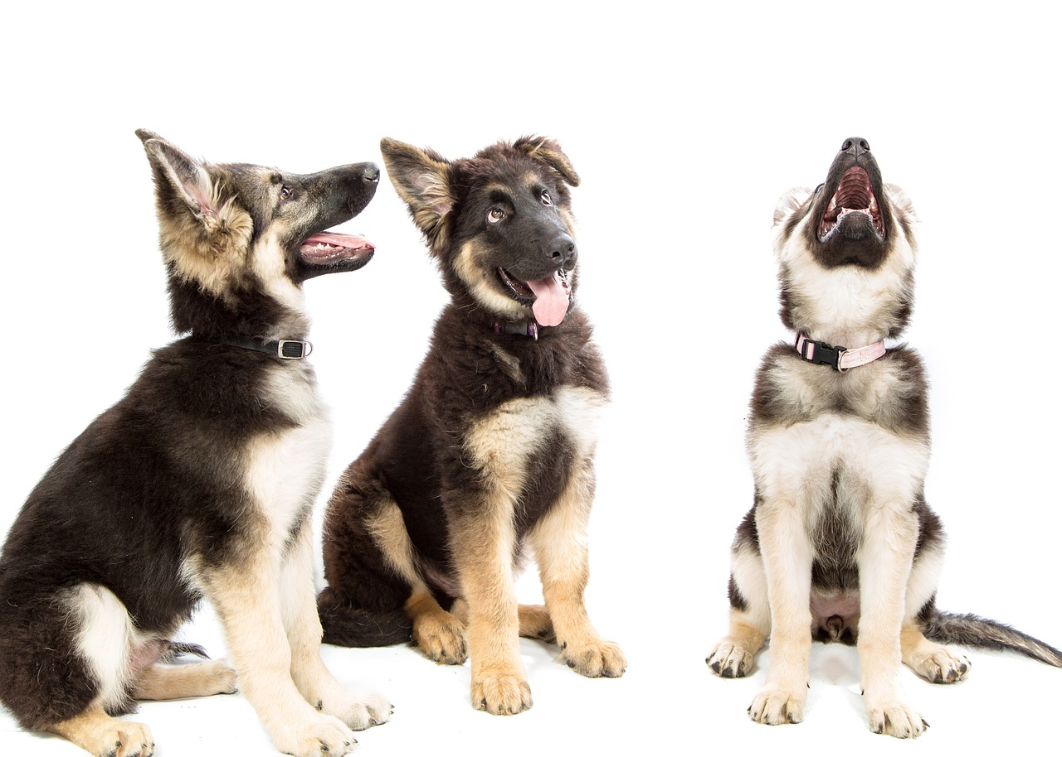
Dog Breed Classification
MSCA 31009 Machine Learning and Predictive Analytics
Narangarav Batbaatar
Robert Erffmeyer
Priya Suvvaru Venkata

Slide 2
Contents
Executive Summary
Data Overview
Exploratory Data Analysis
Model Development
Final Model Assessment
Conclusions
Notes:
Scope - not tagging everything on the images, only classification dogs
Eda - 4-5mins
-solo dog images vs images with noise and with other objects
Model Development
-Nara 2
- Priya - 2
- rob - 1.5 mins
-what we picked, how we did it , precision vs recall
- final model assessment
- picked last one because (show summary statistics)
Room for improvement
Go beyond classifying dogs - object detect other things such as people, etc.
Create a pipeline that draws boundary box around each dog, and crops image prior to classifying breed.

Slide 3
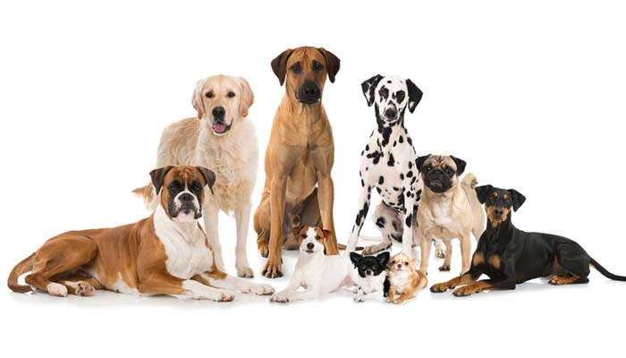
Executive Summary
What breed is that pup? The most common question
asked at a dog park…
The project aims at using CNN to answer the question
What differentiates dogs
Morphology: ex: body size, skull shape, tail phenotype, fur type, body shape, coat colour
Behavioural: ex: guarding, herding, hunting
Personality: ex: hypersocial behavior, boldness, aggression.

Slide 4
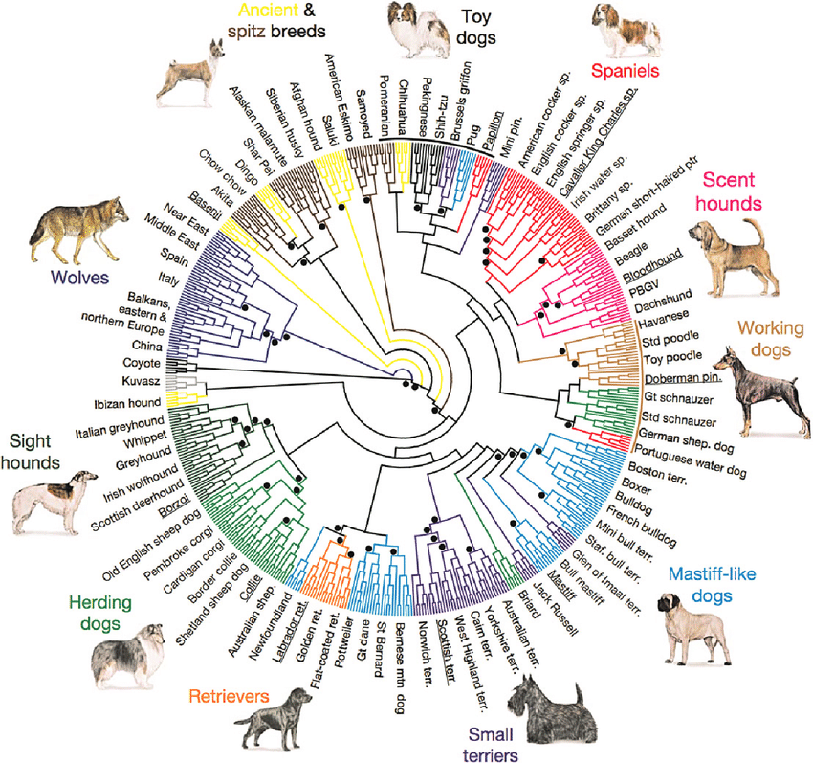
EDA - Dog Breeds -
Expert Knowledge
Domestic dogs are divided into over 175 breeds, with members of each breed sharing significant phenotypes.
Fun Fact: Artificial selection produces up to 450 breeds of dogs
Source: ILAR journal / National Research Council, Institute of Laboratory Animal Resources 55(1):59-68
DOI:10.1093/ilar/ilu017

Slide 5
Data Overview
Source: Stanford
About:
120 dog breeds
~150 images per class
Total images: 20,580
Characteristics of data
Fine-grained classification
Balanced Training Set (100 images for 120 breeds)
Potential Issues:
Resolutions vary
Off Center Dogs
Many images have non-dog objects also in the pictures
Similarity of many dog breeds

Slide 6
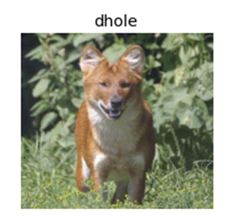
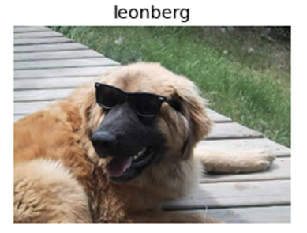
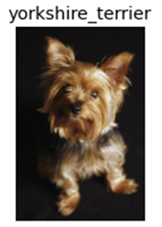
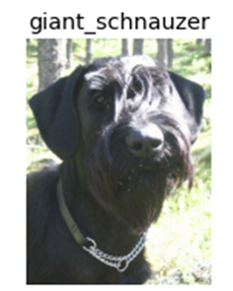
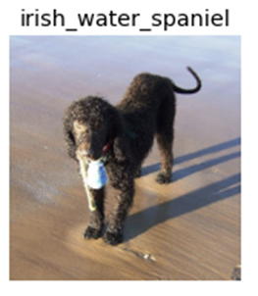
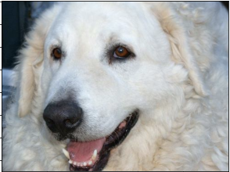
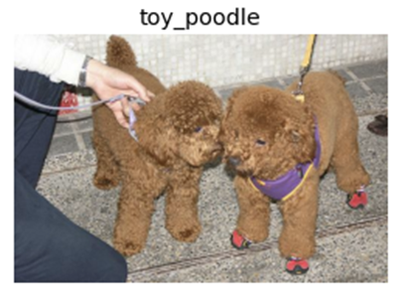
Example Images

Slide 7
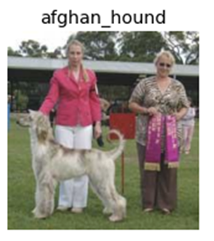
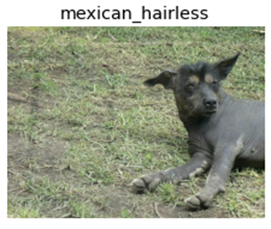
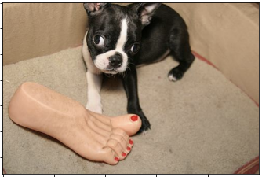
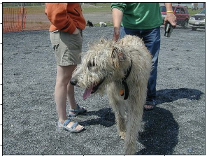
Example Images - Potentially Problematic

Slide 8
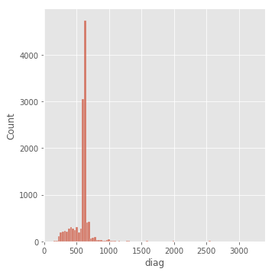
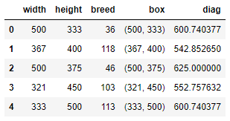
EDA - Stanford Dogs - Varying Resolutions
Varying Resolutions
Notes:
Include final bar graph that’s flat and wide at bottom

Slide 9
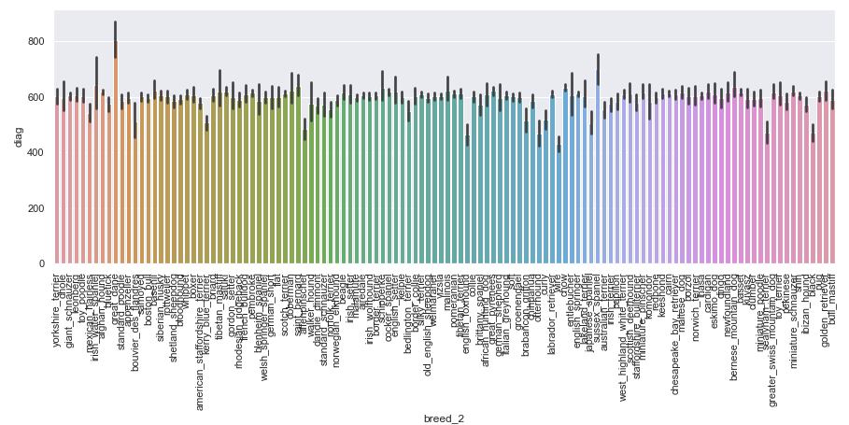
EDA - Stanford Dogs - Varying Resolutions
Varying Resolutions
Notes:
Goofy slide.
Data Table of top 5 dog breeds by resolution, bottom 5 dog breeds by resolution
Do the bottom 5 dog breeds by resolution have lower recall / precision scores?

Slide 10
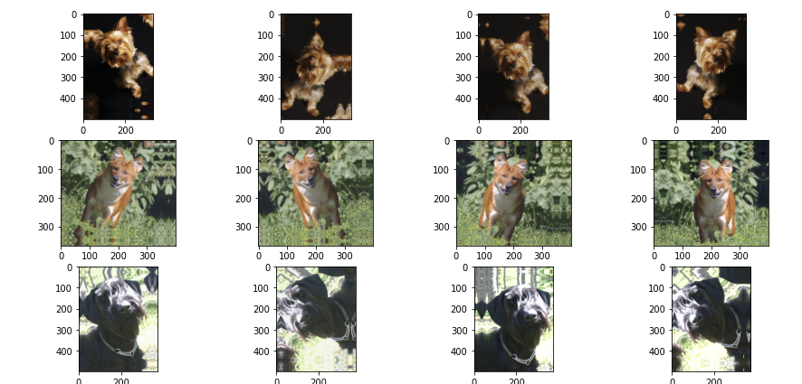
Data Augmentation

Slide 11
Model Overviews
For the purpose of the project we have used the following models:
CNN from scratch
MobileNetV2
EfficientNet_B0

Slide 12
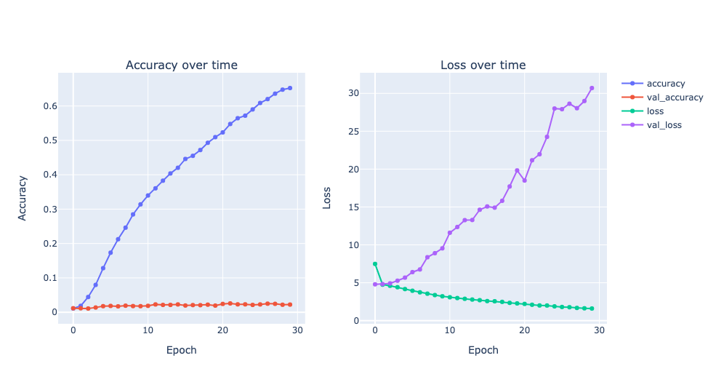
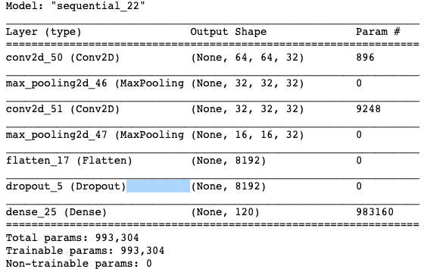






Model Development - CNN
Without dropout layer accuracy is 0.83.
With dropout layer accuracy is 0.65, overfitting issue is not resolved.

Slide 13
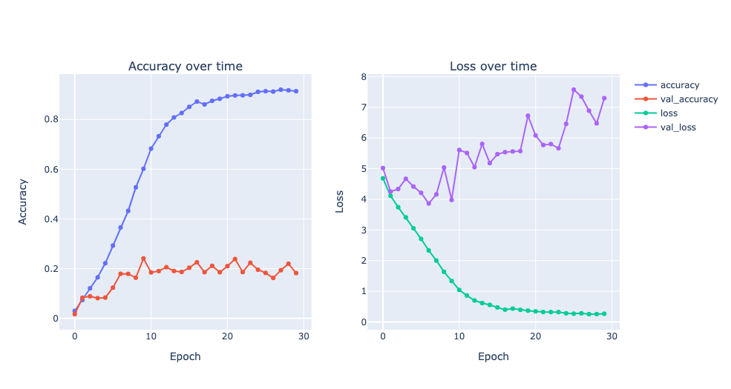
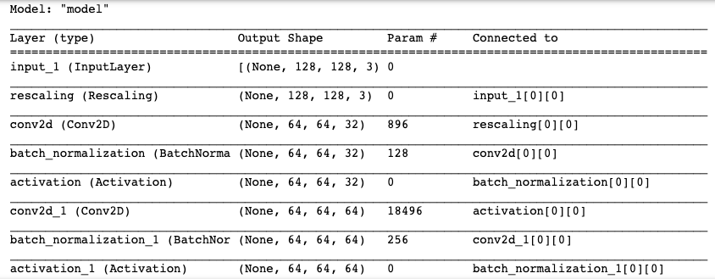
Model Development - CNN
Added layers:
BatchNormalization
Activation
GlobalAveragePooling
Convolutional
Accuracy = 0.91
Strong overfitting
Need to implement augmentation

Slide 14
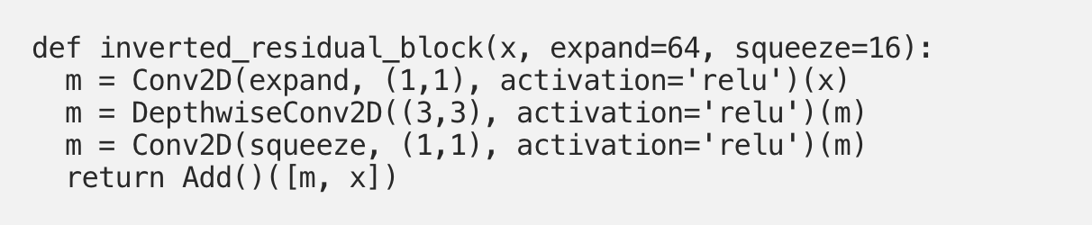
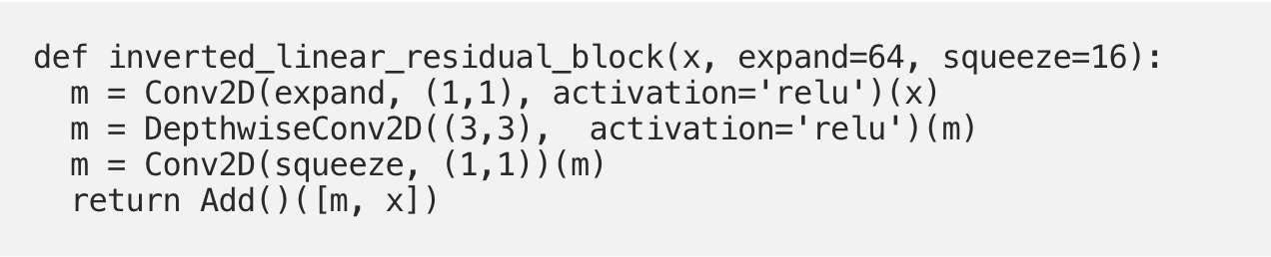
Model Development - MobileNetV2
Architecture: CNN
Batch size: 32
Number of epochs: 30
Key Concepts:
Inverted Residuals
Linear Bottlenecks
Batch Normalizers
Relu6 Activation

Slide 15
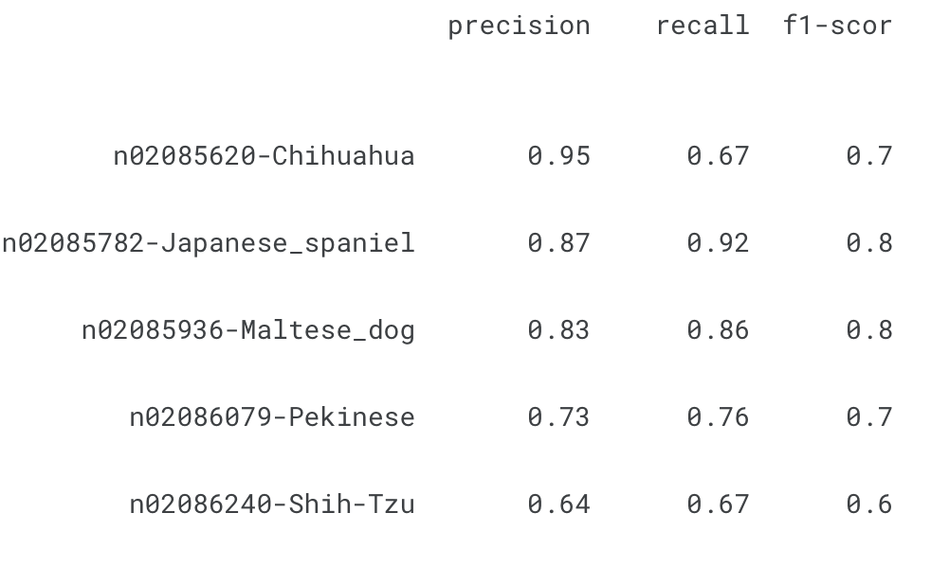
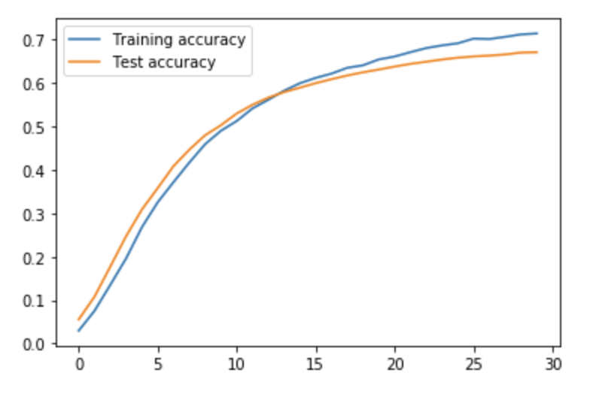
Model Development - MobileNetV2

Slide 16
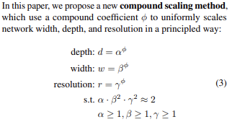
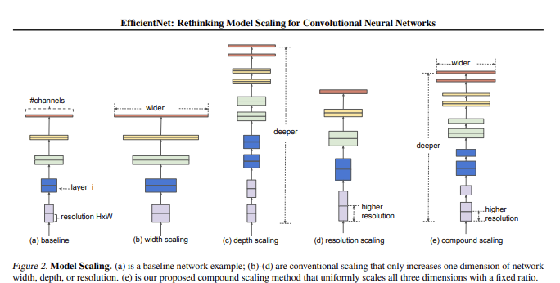
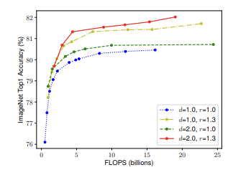
Model Development - EfficientNet_B0
EfficientNet: Rethinking Model Scaling for Convolutional Neural Networks ~ 2020
Notes:
https://arxiv.org/pdf/1905.11946.pdf

Slide 17
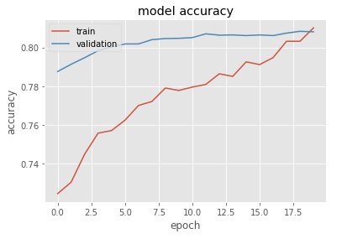
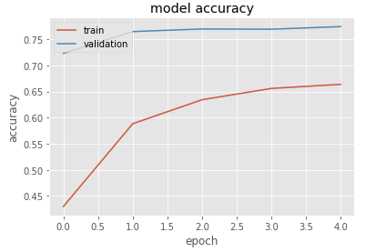
Model Development - EfficientNet_B0
Transfer Learning - Model Architecture
Model is Efficient Net originally trained on ImageNet (1000 classes)
Efficient Net 0 takes input images of shape (224, 224, 3)
transfer learning, exclude original top layer (softmax 1000 nodes) and rebuild with GlobalAveragePooling2D, and 120 node dense layer with softmax output
Transfer Learning - Training Regimen
freeze all layers and train only the newly added top layer (with large learning rate, 3-5 epochs)
unfreeze a remaining layers and fit the model using a very smaller learning rate. - fine tuning approach
Notes:
Fix up

Slide 18
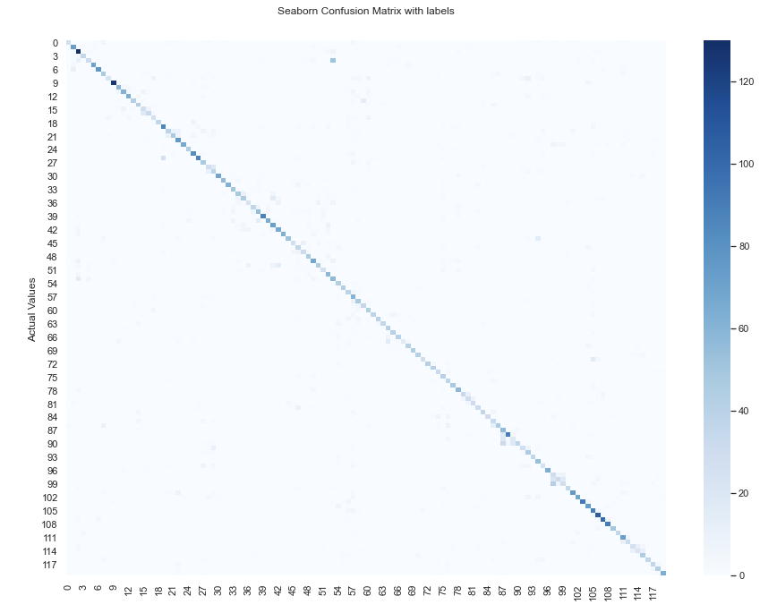
EfficientNet_B0 - Classification Results
Notes:
Add confusion matrix / classification reports

Slide 19
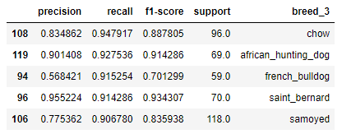
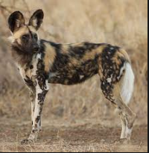
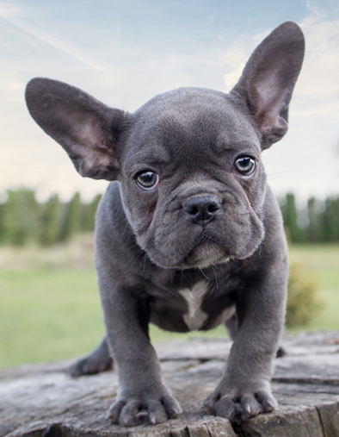
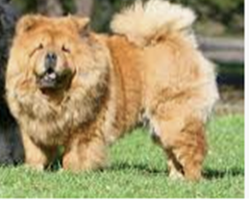
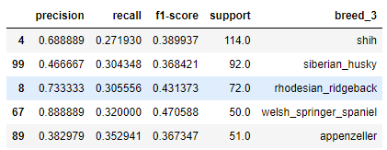
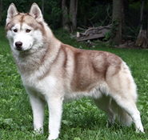
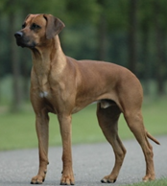
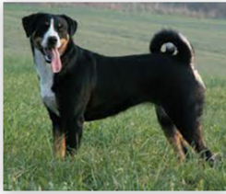
EfficientNet_B0 - Classification Results - Recall
Notes:
Add confusion matrix / classification reports

Slide 20
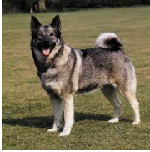
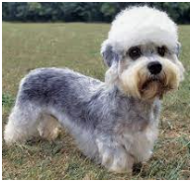
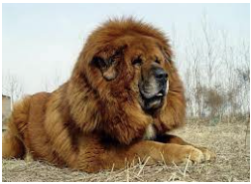
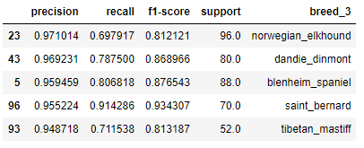
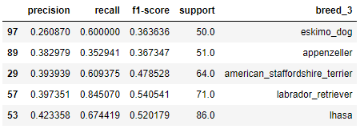
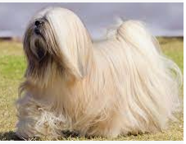
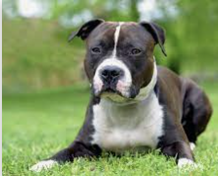
EfficientNet_B0 - Classification Results - Precision
Notes:
Add confusion matrix / classification reports

Slide 21
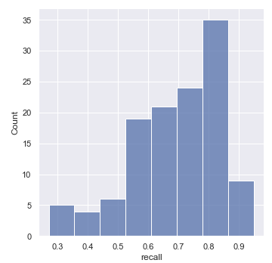
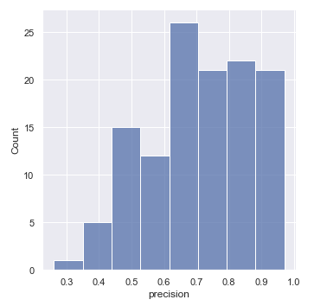
EfficientNet_B0 - Classification Results
Notes:
Add confusion matrix / classification reports

Slide 22
Model Selection
Model | Accuracy
CNN | 65%
MobileNetV2 | 76%
EfficientNet_B0 | 81%

Slide 23
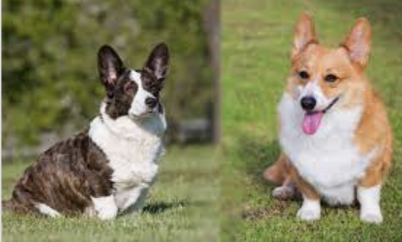


Mis Classified Breeds Across Models
Silky vs Yorkshire Terrier
Pembroke vs Cardigan
Greyhound vs Whippet

Slide 24
Future work
We’ve learnt that the Stanford data set is limited in it’s variety of dogs - we would like to expand the testing of the models on random data sets of dogs
Study for overfitting on the bigger data sets
Increase accuracy on bigger data sets
We’d like to continue down this path to make an app of it

